Slide 1
Individual Meeting
Jason Chang

Slide 2
What’ve I done in the past two weeks?
TSMC JDP Project
Kubernetes, Helm, Istio
Train Ticket with k8s + istio (using minikube to create k8s cluster)
On Automatic Parsing of Log Records
ICSE 2021 (#15 conference), #citations = 2
GoEdge.ai
General Framework for FactoryAI and its implementation with Darts
Myself
TIST 2022
2 major revision + 1 reject with strong encouragement for resubmission = reject?

Slide 3
TSMC JDP meeting
台積電這周的JDP開會：周四上午11點~12點
老師剛好這週有事情，先skip這次會議

Slide 4
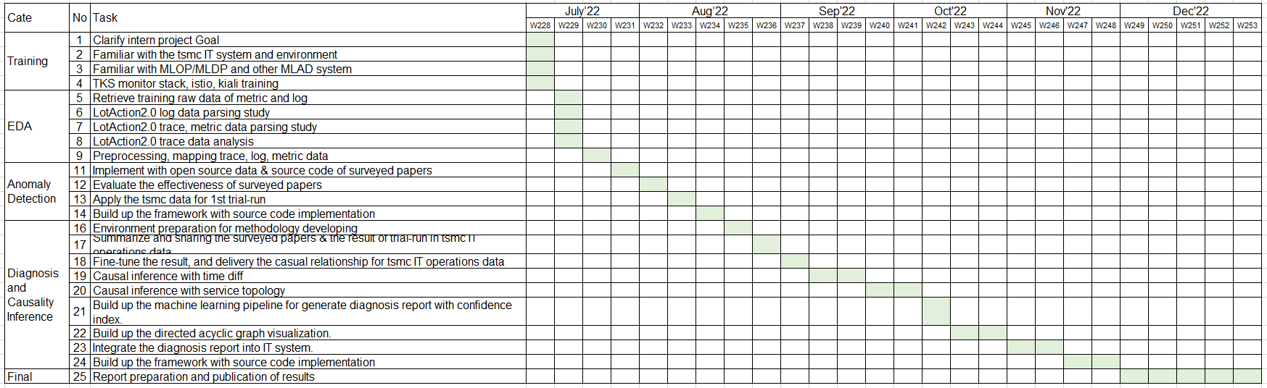
Internship plan (from TSMC)
7月完成台積資料parsing
8~9月完成surveyed paper implementation
10月完成causal inference
11月完成framework以及與台積IT系統整合
12月底前完成報告撰寫 (論文明年2月底前完成即可)

Slide 5
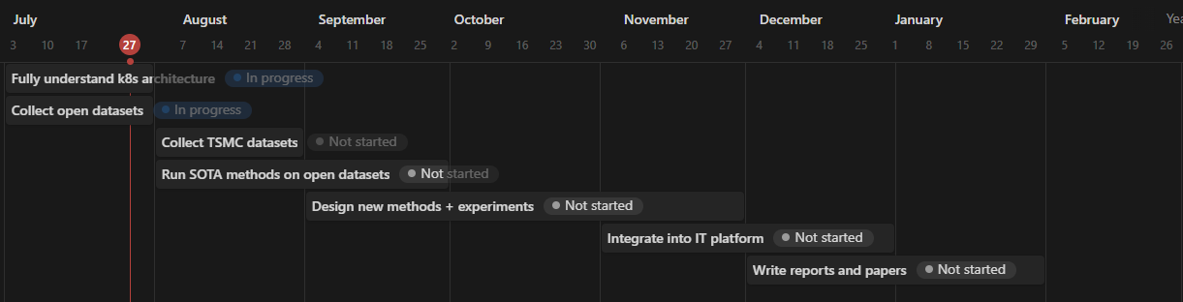
Internship plan (from NYCU)

Slide 6
Problem Settings
Metric: ready
Log: ready
Trace: not ready
Changelog: ready, very important
Supervised or Unsupervised | Unsupervised
Offline or Online | Online
Data type | Metric + Log + Trace + Changelog
Data source | System log (kubernetes-related) Application log
Others | Multiple sources time mismatch log sparsity issue (error message) Log parsing Causality/Interpretability/Explainability
Keywords: micro services, causal graph, root cause analysis, causal inference

Slide 7
2 main problem settings
Problem setting | Log Parsing | RCA with microservices
Supervised or Unsupervised | Unsupervised | Unsupervised
Offline or Online | Online | Online
Data source | Log | Metric + Log + Trace + Changelog
Others | Multiple sources Log type System log (k8s-related) Application log | Multiple sources Log type (same as log parsing) time mismatch log sparsity issue (error message) Causality/Interpretability/Explainability

Slide 8
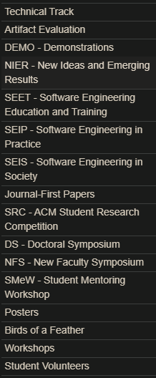
On Automatic Parsing of Log Records
ICSE 2021 (#15 conference), #citations = 2

Slide 9
Introduction
They explore the possibility of automating the parsing task by employing machine translation (MT).
They create a tool that generates synthetic Apache log records which we used to train recurrent-neural-network-based MT models.

Slide 10

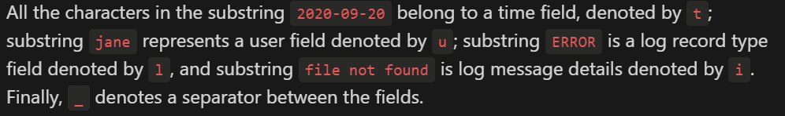
Problem Settings
Input
An input string of the raw log
Output
The field type that a given input character is mapped to

Slide 11
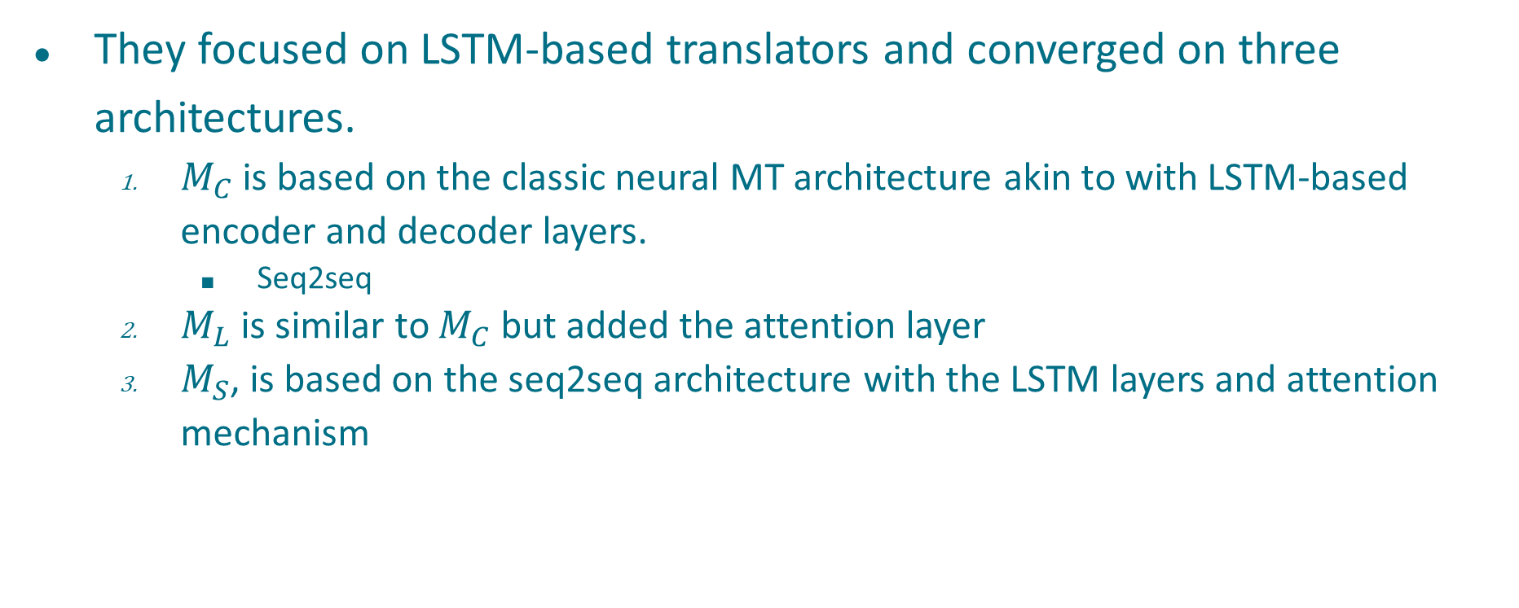
Models
They focused on LSTM-based translators and converged on three architectures.
$M_{C}$ is based on the classic neural MT architecture akin to with LSTM-based encoder and decoder layers.
Seq2seq
$M_{L}$ is similar to $M_{C}$ but added the attention layer
$M_{S}$, is based on the seq2seq architecture with the LSTM layers and attention mechanism

Slide 12
Synthetic logs’ generator
They focus on log formats of the Apache HTTP server
“For the training of the DNNs, we need not only the raw log strings, which will serve as input to a DNN, but also the information about the log strings' format that will be used as output from the model.”
Supervised learning!
Not suitable in our case

Slide 13
Summary
This work is of interest to researchers as it provides novel insights into the log parsing field.
The quality of our models' translation is not adequate for the practitioner at this stage, but we hope that this work will inspire others to explore various MT approaches and improve upon our results.

Slide 14
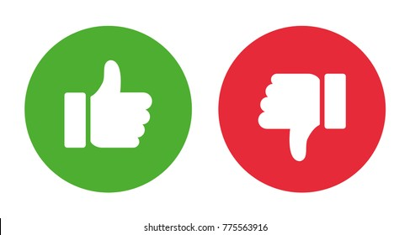
Connection with UniParser
In this work, they formulate log parsing as MT problem; in UniParser, the forlumate log parsing as classification problem
Is the machine translation technique appropriate here?
Both are supervised learning (do we have to use labeled data to train NLP-related NN?)
Learn from context
Problem with UniParser
Supervised learning
Self-supervised
Use Drain’s rule to define positive pairs and negative pairs

Slide 15
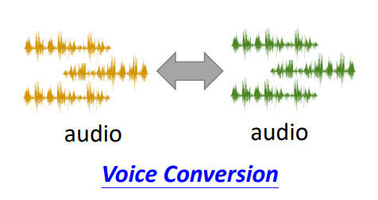
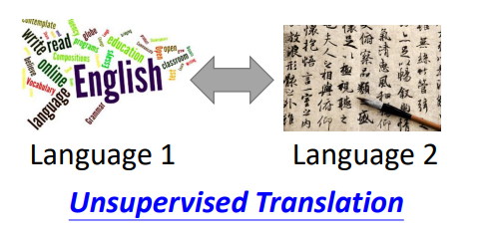
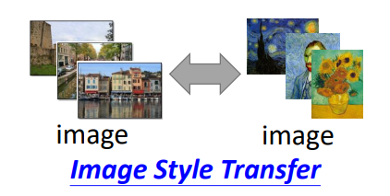
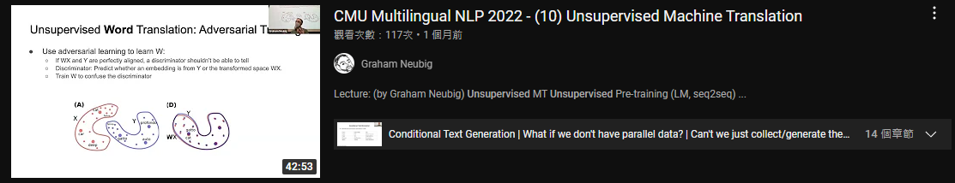
Unsupervised = Learning from Unpaired Data

Slide 16
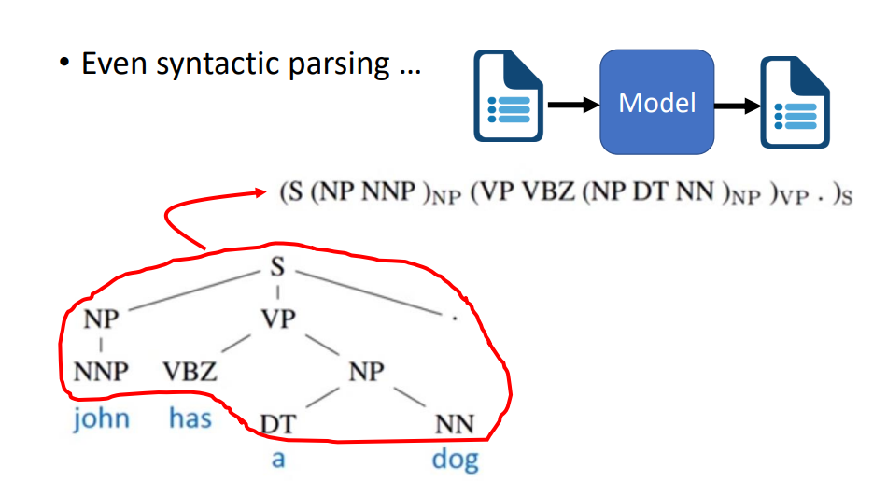
Can we use unsupervised seq2seq to tackle this problem?

Slide 17
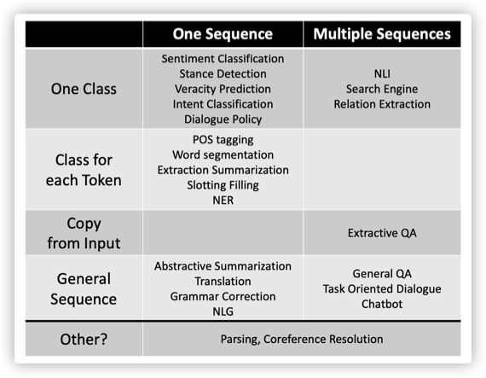
Machine Translation?

Slide 18
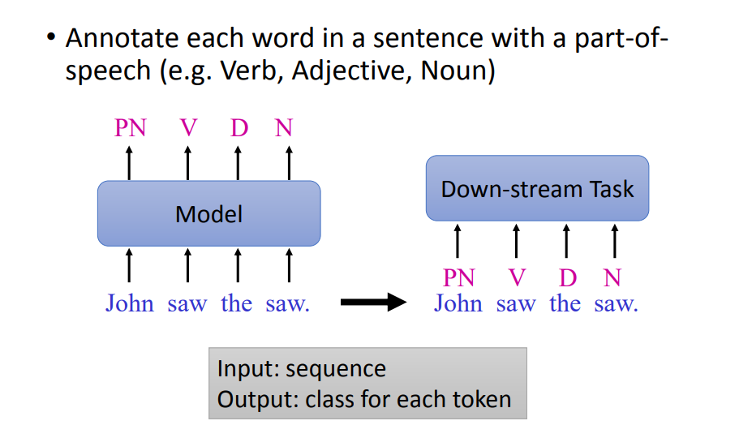
POS tagging

Slide 19
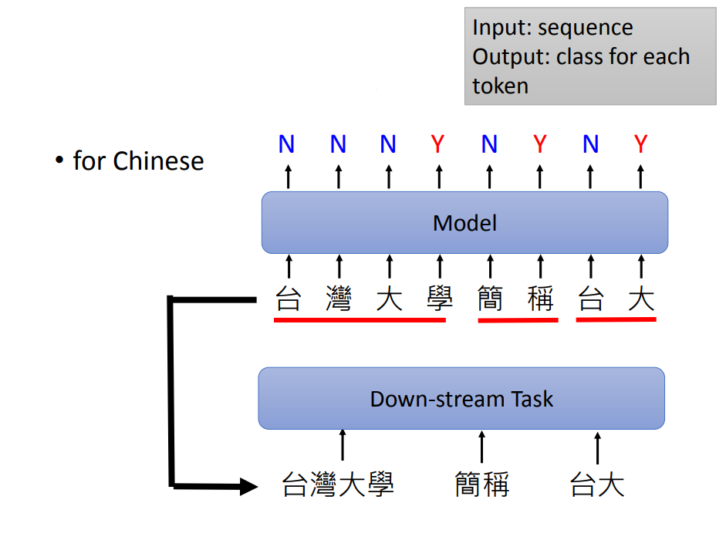
Word Segmentation

Slide 20
Research directions
Log parsing with NN (NLP-related)
…
Unsupervised POS tagging
A Grounded Unsupervised Universal Part-of-Speech Tagger for Low-Resource Languages
NAACL-HLT 2019 (#45 conference), #citations = 8
Unsupervised word segmentation
Unsupervised Word Segmentation with Bi-directional Neural Language Model
TALLIP 2021 (Q2 journal), #citations = 6
Unsupervised Word Segmentation using K Nearest Neighbors
Submitted to Interspeech 2022 (written in 2022/04), #citations = 0

Slide 21
Survey paper for log parsing
Tools and Benchmarks for Automated Log Parsing
Same authors as the CSUR paper below
A Survey on Automated Log Analysis for Reliability Engineering
CSUR 2021 (Q1 journal), #citations = 34
Authors for logpai, loghub, drain, ...
The extended version of Drain was based on a directed acyclic graph that allowed log group online merging. In addition, it provided the first automated parameter tuning mechanism for log parsing.
Logram is the current SOTA parser.

Slide 22
Conclusion
Instead of using Drain, we want to develop a method that consist of these properties:
Unsupervised learning
Learn from context
NLP-related task, like MT, POS tagging, word segmentation
(Optional) Self-supervised learning

Slide 23
Thanks for your attention

